Slide 1
Dual Enrollment (DE):
How To Apply

Slide 2
Make an appointment with your High School counselor
Ask your High School counselor if you have completed the High School courses to be eligible for the Dual Enrollment (DE) program.
Your High School counselor will provide a PERT test authorization form, if you haven’t taken an ACT or SAT already.
To schedule a PERT test, contact the testing center at 305-809-3185 or Marissa Owens at 305-809-3207.
Set up an appointment with your High School counselor.

Slide 3
PERT Authorization Form
Mile Marker 106.4

Slide 4
Required College Placement Scores​
ACT​
Math-21​
Reading-19​
English-17
SAT​
Math-25.5​
Reading-24 ​
Writing & Language-25
PERT​
Math- 123​
Reading- 106​
Writing- 103

Slide 5
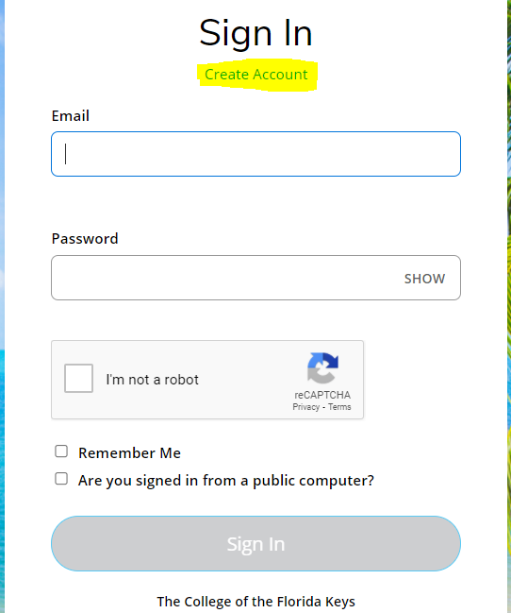
Apply to CFK
Visit cfk.edu/apply-now/ and create an account. Once your account is created, choose create a new application. You will then choose the second option, Start a new Dual Enrollment (DE) application. (*If you are asked to make a payment, you have chosen the wrong application. Dual Enrollment (DE) applications are free.)

Slide 6
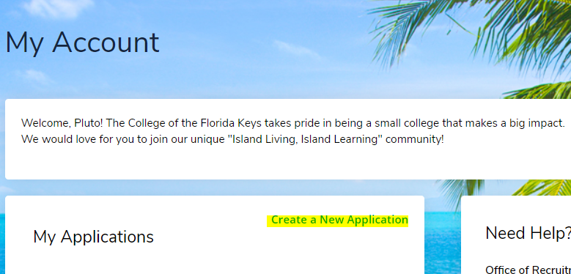
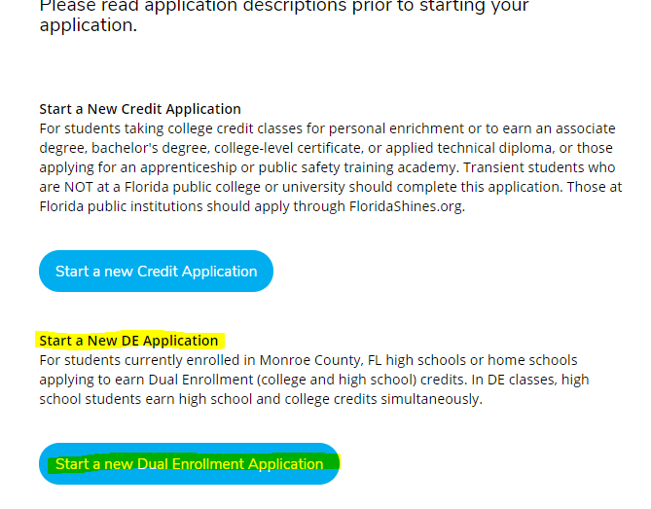
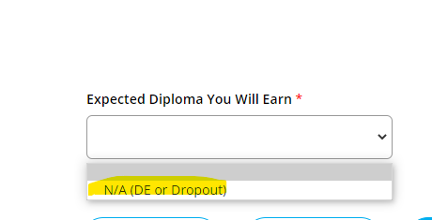
Proceed to complete the application, at the bottom of each page, click save & continue.
*Under academics choose attended from the month/year that you started 9th grade.
Attended to the current month/year.
*Expected High School graduation date will be May of the year you graduate.
*Expected diploma you will earn-choose the only option available, N/A (DE or Dropout)

Slide 7
Application for Admission Form
This form will need to be completed with your High School counselor. The form will show your PERT scores and that your counselor approves of you entering the Dual Enrollment (DE) program. The form must have the counselor and student signature. Once the form is completed, please send to advising.services@cfk.edu or drop off at CFK Enrollment Services window.

Slide 8
Choose your classes
Your next step is to choose the course you want to take and complete the Dual Enrollment Authorization form. DE Math classes are available at the High School. When choosing courses that take place at CFK, please be mindful to choose those courses at the end of the day, night classes, or virtual classes. This form will need to be signed by your High School counselor and the student. The form will then need to be dropped off at CFK or emailed to advising.services@cfk.edu.
The Advising team at the College is there to assist you with course selection and answer questions about becoming a Dual Enrollment (DE) student. You can contact advising at 305-809-3196 or advising.services@cfk.edu.

Slide 9
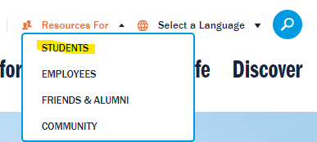
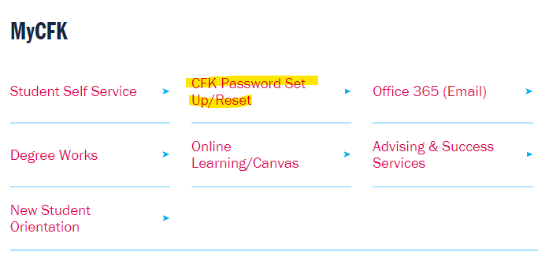
Preparing for College Classes
You should have received an acceptance email with your student ID and instructions on how to reset your password. (If you have a gmail account, CFK communications will sometimes go to your promotions inbox)
To reset your password, visit CFK.edu, click on resources for and choose students.
Scroll down under MyCFK and click on password set up/reset. Fill in your first name, last name, birthday, and then use your student ID. Once this is completed, you will use this password to sign-in on all platforms used within CFK. Your username will be your Firstname.Lastname

Slide 10
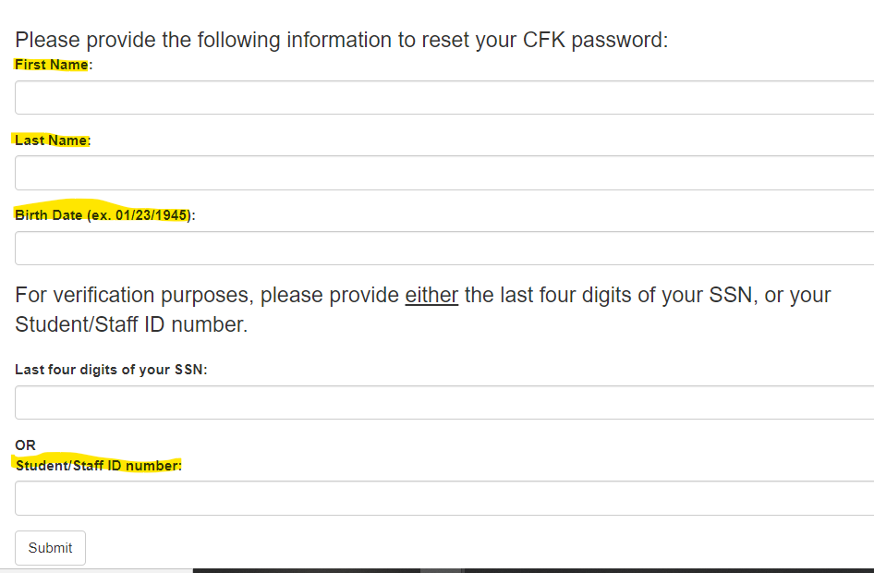
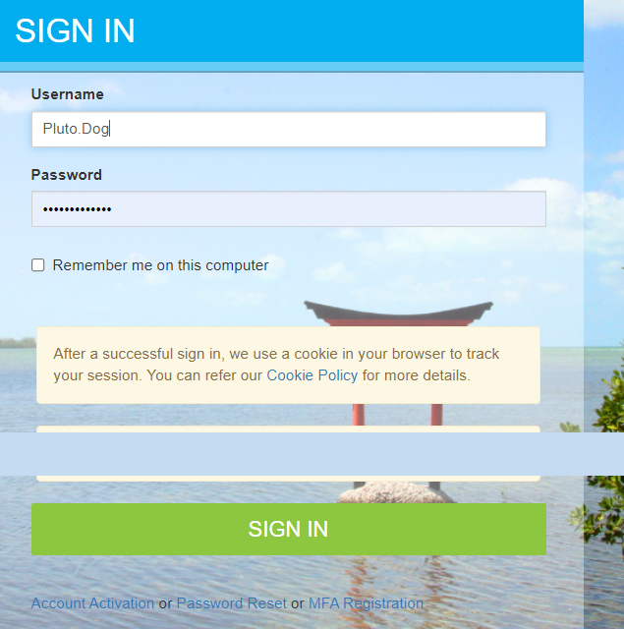

Slide 11
Setting up your CFK email
Under MyCFK choose Office 365 (Email).
You will then be taken through the process of setting up your email.
It will ask you to start by getting the app (do not use the app), choose I want to set up a different method.
Choose phone, this allows you to authenticate your email by receiving a code texted to your phone.
Enter your phone number, receive the code, enter code, and then you will receive the Success! Message. You will then have access to your CFK email.
You can then download the Microsoft 365 app to receive notifications on your phone.
*Please see pictures on next slide.

Slide 12
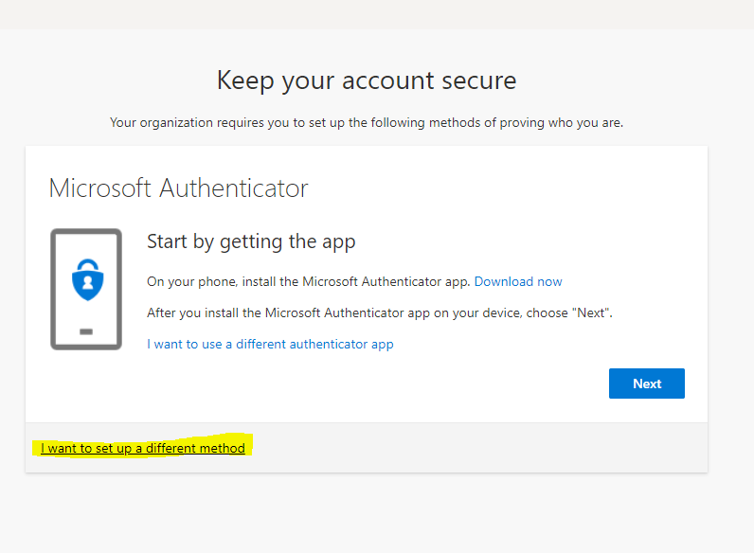
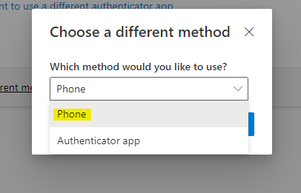
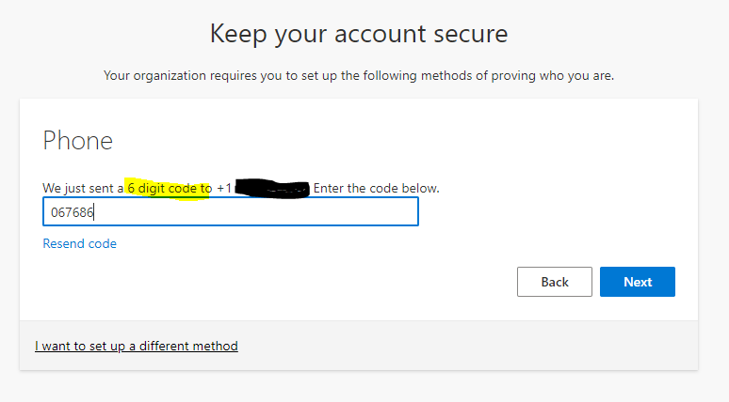
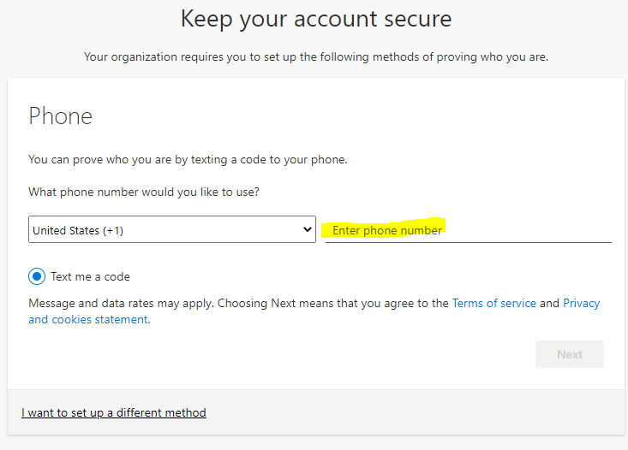
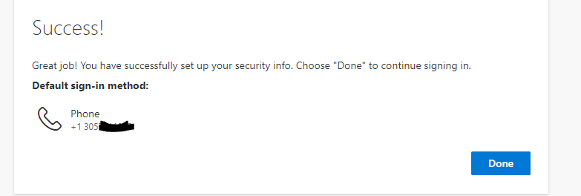
1.
2.
3.
4.
5.

Slide 13
Finding Your Student Schedule
Visit www.cfk.edu/resources-for-students/
Under MyCFK, click on student self-service, and sign-in.
Go to the registration tab and then choose student detail schedule.
Choose the term you would like to see the schedule for.
Take a screenshot of your schedule and send to your High School counselor.

Slide 14
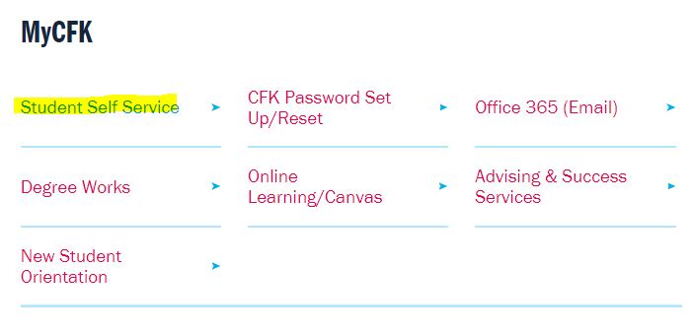
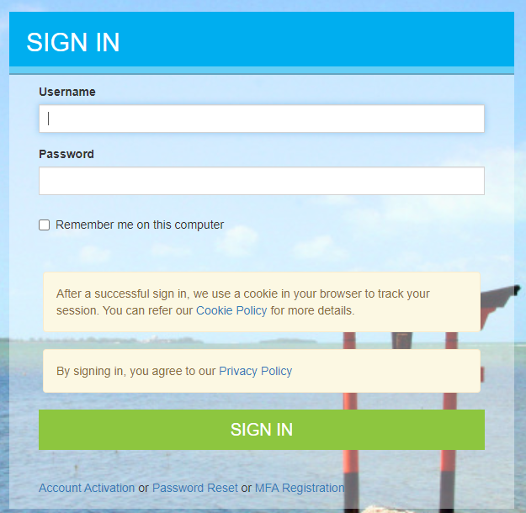
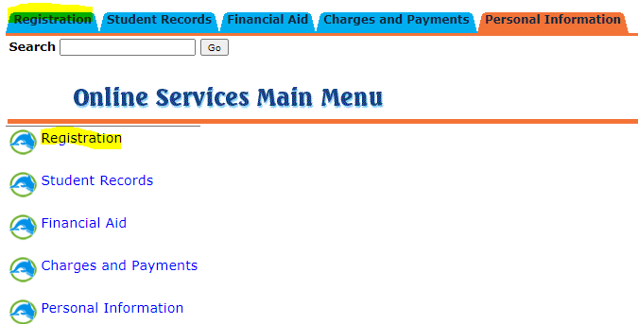
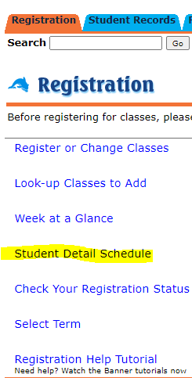
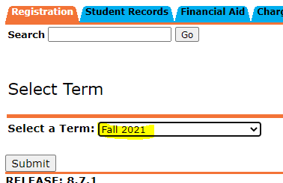
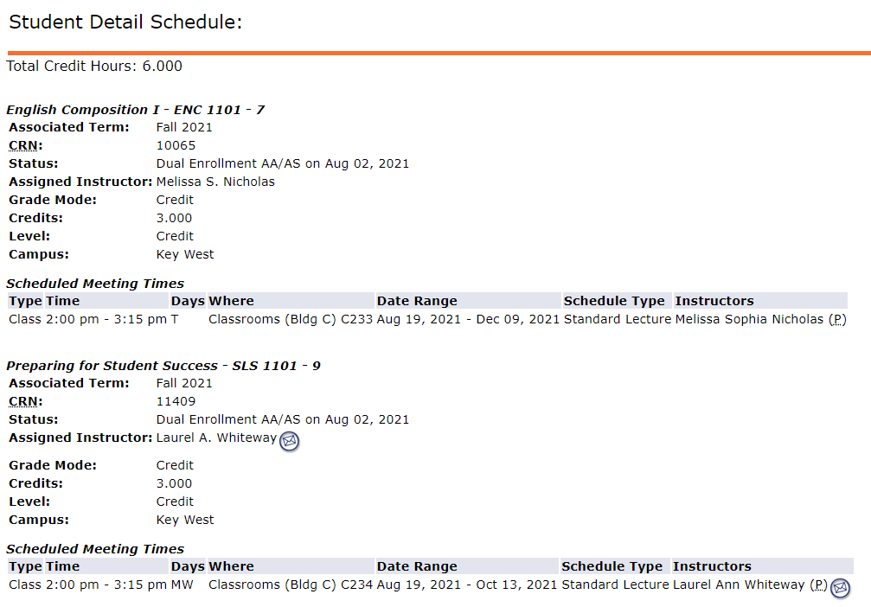
1.
3.
2.
4.
5.
6.

Slide 15
Book Vouchers
Students will need to get a book voucher. This will allow you to order the book for your class from the CFK bookstore.
Email Sarah.Smith@keysschools.com a picture of your DE course schedule. She will email you the form to print out, sign, and bring to the bookstore. You will only need one voucher if you are taking multiple DE classes.

