Slide 1
Ready, Set, College!
Securing Financial Aid

Slide 2
Jeffrey Smith, Director of Financial Aid Kathryn Courtney, Financial Aid/VA Coordinator Gurleen Mohan, Assistant Director CFK FINANCIAL AID 5901 College Road | Key West, FL 33040 Telephone: 305-809-3523

Slide 3
What is financial aid?
Financial assistance that helps a student bridge the gap between the student’s funding ability and the Cost of Attendance.
Cost of Attendance is based on tuition and fees, room and board, books and supplies, and transportation.
Financial Aid includes grants, loans, work-study, and scholarships

Slide 4
Federal Grants
PELL Grant
Need-based
Based upon Expected Family Contribution (EFC) and enrollment hours
Max award for 2021-2022: $6,495
SEOG (Supplemental Educational Opportunity Grant)
Campus-based funding

Slide 5
Federal Loans
Direct Loans
Subsidized – No interest while enrolled at least half-time
Unsubsidized – Interest charged but no payment required
Annual limits: $5500 for 1st year students
The current interest rate is 3.73%.
PLUS Loans (Parent Loan for Undergraduate Students)
Credit Based
Up to Cost of Attendance, minus any other aid student is receiving
The current interest rate is 6.28%.

Slide 6
Federal Work Study
Need-based
Limited funding
Part-time
Cannot work more than 20 hours/week at CFK

Slide 7
Scholarships
Institutional Scholarships
Academic Works: https://cfk.academicworks.com/
General Scholarship deadline in early Spring
Departmental Scholarship deadlines vary
Other Sources
High School website/guidance counselor
Your/your parent’s place of employment
Organizations
Private foundations
Online searches

Slide 8
2022-2023 FAFSA
Apply, beginning October 1
2020 tax documentation
Can be completed online or via mobile app
Fafsa.ed.gov
myStudentAid Mobile App

Slide 9
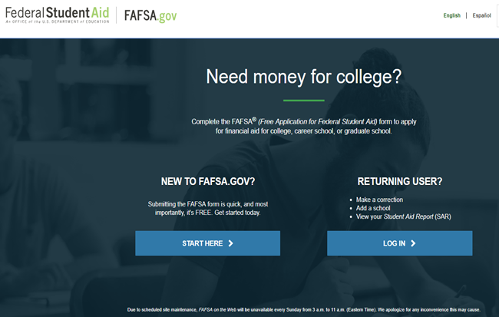
How To Apply For Federal Student Aid - website
Complete the Free Application for Federal Student Aid (FAFSA)
Apply at www.fafsa.ed.gov
CFK School Code - 001485

Slide 10
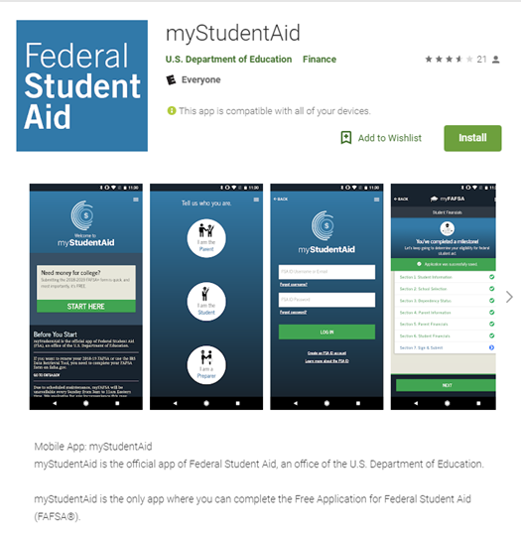
How To Apply For Federal Student Aid - app
Complete FAFSA on your mobile device
Google Play https://play.google.com/store/apps/details?id=com.fsa.mystudentaid
Apple App Store https://itunes.apple.com/us/app/mystudentaid/id1414539145

Slide 11
Estimated Cost of Attendance at CFK Per Semester
EXPENSES | Florida Resident living with Parents
Tuition | $ 1,310.64*
Books and Supplies | $ 707.00
Room and Board | $ 2185.00
Transportation | $ 1,475.00
Personal Expenses | $ 739.00
Estimated Total Cost | $ 6,416.64
*Based on 12 credit hours & does not include course fees

Slide 12
Estimated Cost of Attendance at CFK Per Semester
EXPENSES | Non-Resident living in Dorms
Tuition | $ 5,264.76*
Books and Supplies | $ 707.00
Room and Board | $ 6641.00
Transportation | $ 400.00
Personal Expenses | $ 739.00
Estimated Total Cost | $ 13,751.76
*Based on 12 credit hours & does not include course fees

Slide 13
Satisfactory Academic Progress
To remain eligible for financial aid, you must:
Maintain at least a 2.0 Grade Point Average (GPA)
Must maintain an overall completion rate of 67% or more for all courses
*If you drop below either metric, you will be placed on financial aid warning. If you don’t meet requirements after the next semester, you will be suspended from receiving financial aid.

Slide 14
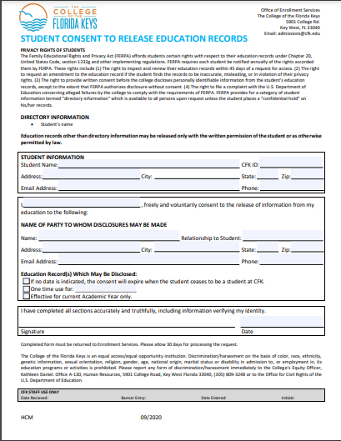
Confidentiality Policy
Family Educational Rights and Privacy Act (FERPA)
Student Consent Form

Slide 15
If you ever have any questions regarding your FINANCIAL AID, please do not hesitate to ask us.
WE ARE HERE TO HELP!!

Slide 16
CFK FINANCIAL AID
5901 College Road
Key West, FL 33040
Telephone: 305-809-3523 financialaid@cfk.edu

